Slide 1

LatentView Analytics
Data Engineering Capabilities
June, 2019

Slide 2
Agenda
1
Introduction to LatentView
2
Data Engineering Capabilities & Case Studies
3
MicroStrategy Capabilities & Case Studies

Slide 3
Introduction to LatentView

Slide 4


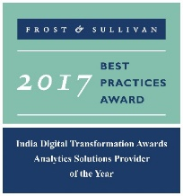




LatentView – A World Class Analytics Company
Awards & Recognition
Founded in
Over
Grown
Work with
600
11
30+
2006
Strong Performer - Customer Analytics Services, 2017
People strong
times in last
six years
Fortune 500
firms
Repeat business at
Member of
Rated as Top
2009-2017
Technology council
10
5%
4/5
>85%
Repeat
business
Analytics companies to work for in India
Re-investment in Research and Development
Top technology companies engage with us

Slide 5

























Trusted Analytics Partner to the World's Most Recognizable Brands

Slide 6
Areas of Expertise
Engineering
Data Pipelines
Data
Data
Wrangling
Structured/
Unstructured Data
Statistical Inference
Visualizations
Model
Interpretation
Machine Learning
Actionable
Insights
Math
Business
Use case
Formulation
Artificial Intelligence
Metrics/KPI Definition
Text Mining
Analysis
Simulations
Process Mining

Slide 7








Service Offering Spectrum
Functional categories
Enablers
Customer Analytics
Marketing Analytics
Supply Chain
Finance And Risk
HR Analytics
CFO Dashboards
Employee Pulse and Retention
Customer Perception
Brand and Competitive
Positioning
Sourcing and
Replenishment
Customer Behavior
Collection Analytics
Talent Acquisition
Campaign Design and Effectiveness
Metrics
Measurement
Trust/Counterfeit
Analysis
Performance and Compensation
Lifetime Value Analysis
Marketing Spend Optimization
Demand-Supply Forecast
Loyalty and Personalization
Attribution Modelling
Inventory Optimization
Personalized Marketing
Innovation
Administration
Cross Sell/Up Sell
End to End Visibility
Innovation Radar
Asset Optimization
Data Engineering
Business-focused Approach to Data Engineering to help adopt modern scalable architectures
Visualization
Reporting and dashboards platforms for Insights and quick view on KPIs

Slide 8


































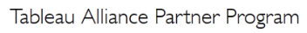
Tools, Technology & Partnerships
Data Engineering
Data Science & Modelling
Data Visualization
Tableau
Measurement Partner
Alliance Partner

Slide 9
Data Engineering Capabilities
Applications
Data Strategy
Data Lakes
Data Warehouse
Visualization
Decision management systems
IoT Applications
Data Monetization Roadmap
Cloud Strategy & Architecture
Architecture Evolution
Data Integration / Consolidation / Harmonization Framework
Optimizing BI Investments
Data Engineering
Capabilities
Technology
Engineering
Hadoop: Hive, HBase, MapReduce, PiG, HDFS, Phoenix
Spark – Scala, Python, Spark SQL
Flume, Kafka, NiFi, Sqoop
Spark Streaming, Storm
AWS, Azure, Kylo, Qubole, Databricks
Structure Data Flows
Ingest streaming & batch data
Data storage and data model
Batch and Real time processing
Real-time, Graph, Search & Iterative workloads
Orchestration
OCM & Managed Services
Organizational Change Mgmt
Governance
Maturity Assessments

Slide 10










Expertise in Cloud Platforms
LatentView is a Microsoft Gold Analytics Partner
Model Automation Framework – LatentView scalable ML solution built in Azure hosted on Microsoft Appsource
Managed Analytics in Azure using AzureML, PowerBI, Azure data factory, Azure Search, Azure data lake analytics etc.
Extensive experience in handling GCP products- AppScript, CloudSQL, Appmaker, Big Query etc. Deep Technical Capabilities to work in this platform
Multiple solutions deployment experience for Google projects
Managed Analytics in GCP using MapR, Cloud ML, Cloud dataflow, Google data studio, Cloud SQL
LV is Advanced Analytics Consulting Partner
Key Presenters of AWS Re-Invent, Business Summit
400 TB cloud migration exercise completed in 3 months
Processing 500+ GB unstructured data per week
Multiple enterprise solutions deployment experience
Managed Analytics in AWS using Amazon ML, Cloudsearch, Kinesis, QuickSight etc.

Slide 11











Key Differentiators
Specialist in Business focused analytics
Single minded focus to create strong Impact on business metrics
33% of our people have business degree
Experts in unconventional data sources & cloud based data ecosystem
Partnership with Amazon AWS & Microsoft Azure
Microsoft’s Gold Analytics Partner
Cutting edge customizable proprietary solutions & reusable Framework
Smart Insights - External data driven trend identification platform to power product innovation
Casper – AI based self-service conservational assistant
Focus on Innovation & Thought Leadership
Institutionalized Idea Labs for innovation and research
Partnership with IIT to create IIT data labs

Slide 12
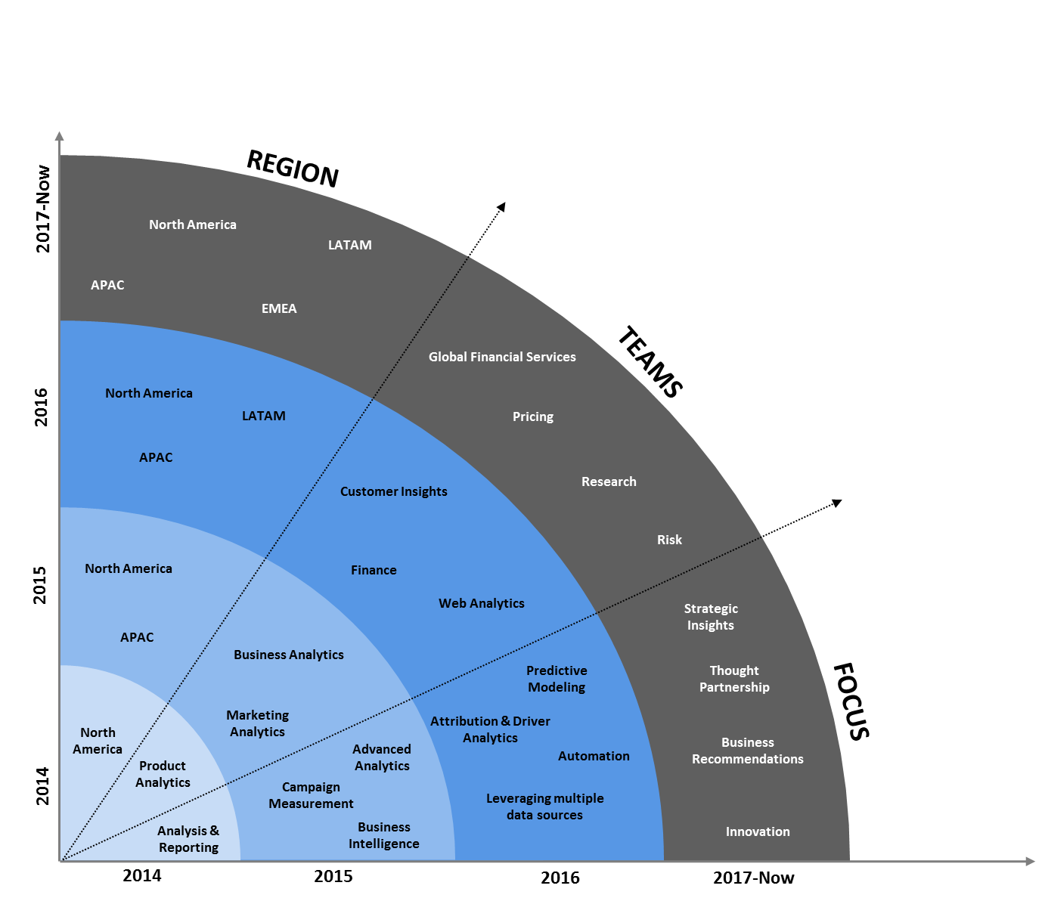



Multi-Year CoE with Leading Payments Provider
Solutions by Business Unit
A single view of campaign performance aggregated at a across geographies that can be drilled further into programs, channels, campaigns according to user role
Marketing Analytics
Customer acquisition and activation journey from TOF to Conversion visualized through Tableau funnel dashboards
Web Analytics
Understand drivers of customer engagement and uncovering factors driving business /product performance.
Consumer
Insight

Slide 13
Data Engineering Capabilities & Case Studies

Slide 14
Enabling the Data Driven Decision Making Journey by…
…getting the data together
…making sense of the data
...applying AI & ML to drive impact
Data Acquisition
Acquiring & consolidating the disparate data sources.
Data Engineering
Integrating various forms of data into centralized data lake using on-premise & cloud based technologies
Data Processing
Process various forms of disparate data – Structured, Unstructured, Physical, Human Interactions, Machine Generated, Real Time etc
Graph Analysis
Exploration of frequency, strength and direction of relationships & Causalities.
Exploratory Analysis
Deep insights from all forms of data using traditional methods (Segmentation & Clustering)
Natural Language Processing
Analyze dimensional insights & relationships by automated tagging
Real Time Analytics
Experience in sub-second big data processing for IOT & real time applications
Deep Learning & AI
Self governing systems leveraging AI & eliminating manual intervention
Machine Learning
Deep experience with various machine learning algorithms, including Ensemble Learning, Neural Networks, etc.

Slide 15










1. Getting the Data Together
How to acquire data?
How to create a unified data view?
How to enable consumption?
Structured Data
External / Internal
Customer Data
Web Data
Data Integration
METRIC & EXCEPTION
REPORTS
Marketing Data
Structured
Payment Data
Data store pipelines enables metric & exception reporting
App Data
INTERACTIVE VISUALIZATON
Data Lake
Dispute Information
API endpoints enabling integration with
other systems
OPERATIONAL
Unstructured Data
External / Internal
Voice Data
Unstructured
ML / AI Workbench for
Prediction & Insights
Chat Data
ADVANCED
ANALYTICS
Email Data
Biometric Data
Social Data
Other data sources

Slide 16
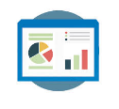




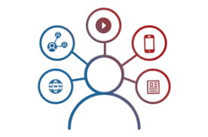


2. Making Sense of the Data
Reporting & Visualization
Performance Management, KPI Measurements
Monitoring & Control
Real Time Assurance, Audit & Compliance
Voice of Customer
Criticalities, Competitive Intelligence
Segmentation & Clustering
Personalization, Appropriateness etc.
Relationship & Causalities
Implementation, Strategy &
Prioritization
Digital Analytics
Consumer Journeys, Marketing Effectiveness
Experimentation
Experimentation at scale, A/B testing etc.
Integrated & Disparate sources in Data Lake

Slide 17



3. AI / ML to Drive Business Impact
Business Planning
Demand Prediction
Market Strategy
Strategic Investments
Early Warning Alerts
Customer Complaints
Transactional Risks
Loss Prevention
Innovation / Insights
Voice of Consumer
Competitive Intelligence
Product Governance
Customer Engagement
Personalization
Acquisition & Conversion
Customer Experiences
Self Serve Analytics through Micro Applications
Complex Data Linearly Scalable With Data Volume
Faster Time To Market Due To Less Set Up Time
Artificial Intelligence / Machine Learning
Integrated & Disparate sources in Data Lake

Slide 18
Ideal Data Ecosystem Vision
LatentView’s Workload-centric architectures help democratize insights beyond data warehousing
Workload Aware Compute
Isolating Compute from Storage for Throttle Free, Optimized, Cataloged, Secured and Accountable Single View
Data Type specific ETL toolset
CANNED REPORTS
Data Integration
Conventional Data Sources
Structured
Relational Data Store
& MPP Databases
Enterprise Reporting Platform
SELF SERVICE BI
Data Lake
Unconventional Data Sources
Indexing and Querying
API endpoints
OPERATIONAL
External Data Sources
Unstructured
Machine Learning Workbench
ADVANCED ANALYTICS
Distributed Processing
Feature Engineering
Data Sampling
Internal Data Sources
Real time Indexing
(Ex: Elastic Cache)
REAL TIME REPORTING

Slide 19
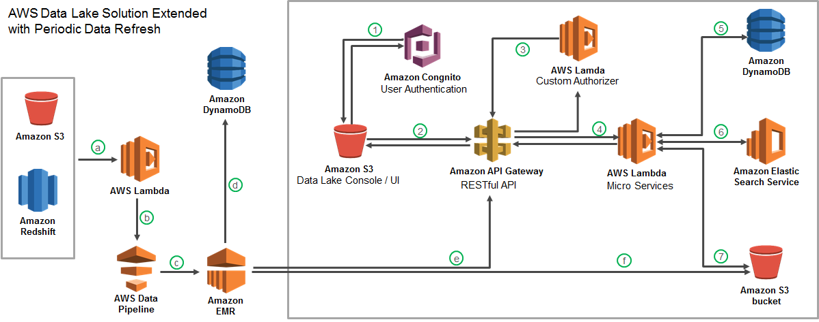




Cloud-based Data Lake to Enhance Analytics Operations
Largest Food Distributor in the US
The Problem: Ageing legacy Business Analytics Infrastructure with high cost of ownership slowing down realizable analytics value
The “Before” State
LatentView Solution
The “After” State
Business users faced significant delays in accessing and analyzing data and had difficulty in handling large volumes of data for analytics
Migrated 60TB of data from legacy systems into a cloud based data lake with extended periodic data refresh which supports reporting and advanced analytics solutions
Reduced cost of ownership and increased throughput of cloud hosted analytics solutions
Recommendation Engine
Order Anomaly Detection
Product Substitution
Revenue Management Use Cases

Slide 20
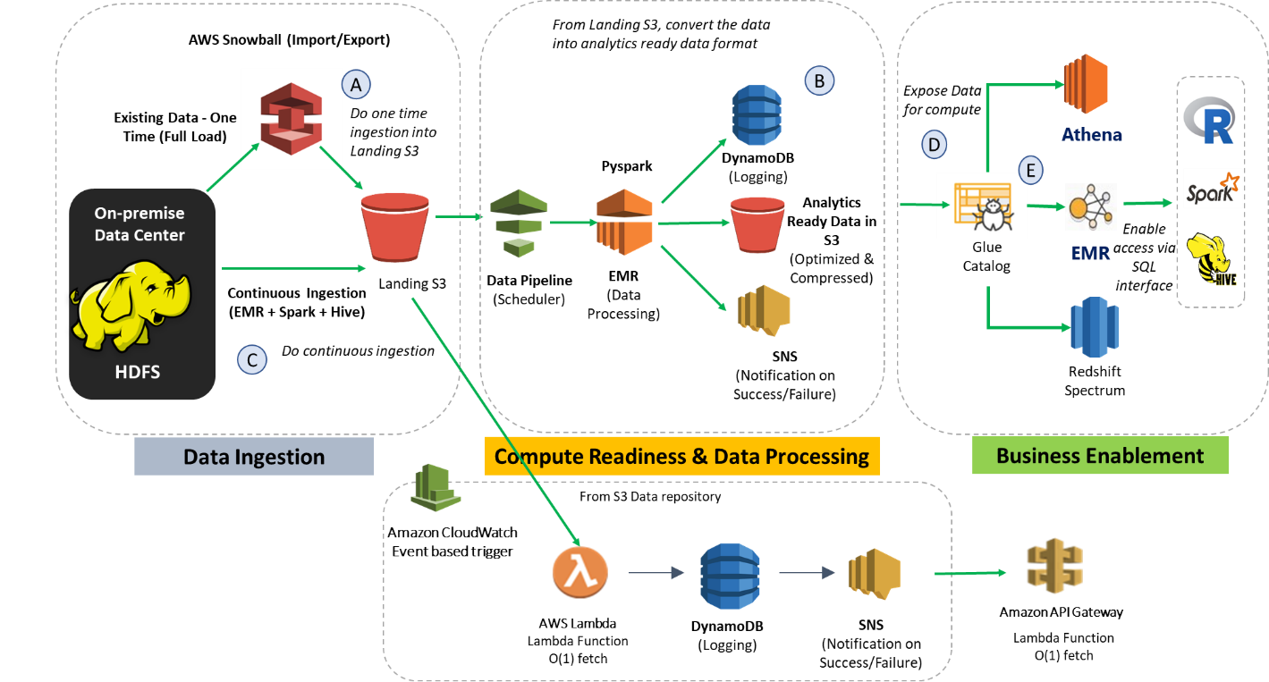
Data Engineering DevOps for a Leading Media Company
Scope
Continue to design & extend the S3 based Data lake in AWS in DevOps mode.
Maintain the data model/schema in S3 same as the existing sources in RawDataHub
Build a scheduled, automated continuous ingestion pipeline in AWS.
Extend the existing data consumption layer for Business enablement team and data science team for quick and easy analytics.
S3 architecture shall be based on an understanding of Functional data landscape – RDH and its respective data sources.
Architecture

Slide 21
MicroStrategy Capabilities & Case Studies

Slide 22
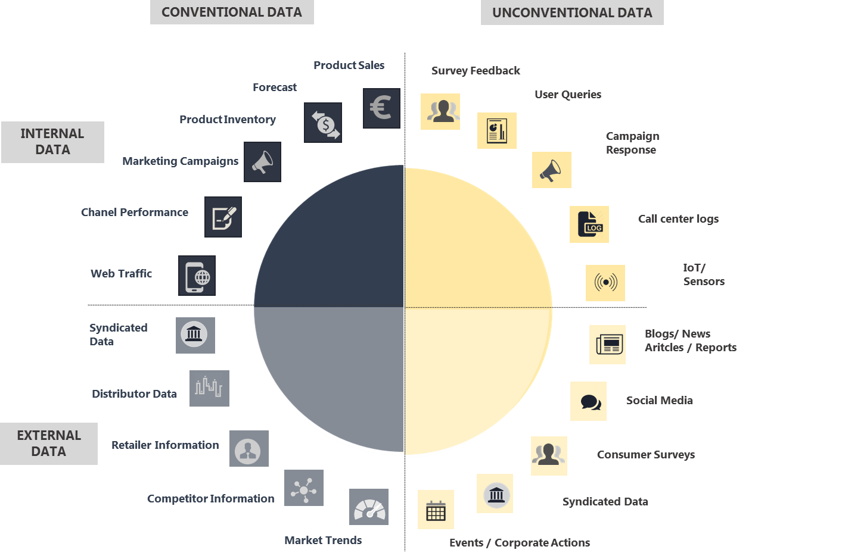


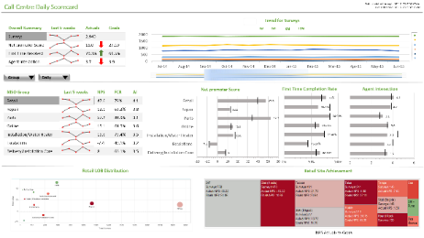
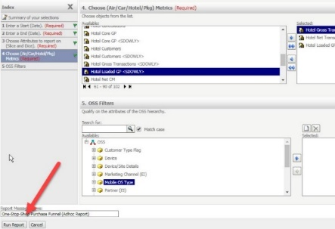
MicroStrategy Expertise – An End to End View
Data Sources
Data Integration Layer
Visualization Layer
-based reporting system
Flat Files
ETL
Historical data
API
Extraction
Transformation
Loading
API
Semantic Layer
API
Meta data
API
Raw data
Summary data
Staging tables
Data mart
Business Understanding
Business Aligned Architecture Design & Processes
Self Service Tool
Differentiation
KPI Framework Alignment
Data & Use Case Validation
Report Automation & Exception Reporting
Case Study:
Identified KPIs, designed and implemented a Teradata based data architecture and MicroStrategy based dashboards to enable weekly business reviews for the home services division of a large US retailer

Slide 23
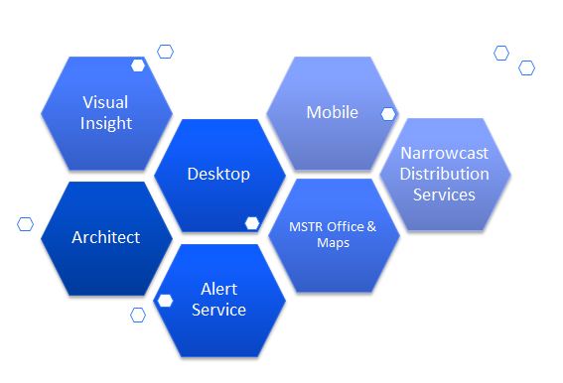
MicroStrategy Capabilities
Snapshots of Assignments
Area | Solution
Member Services Analysis | Automated Self Servicing Reporting services for Call center Analytics
Parts Sales analysis | Monitoring Parts sales and distribution.
Home Services Reporting | Response Time Reporting
Offering consultation for reporting solution with an extensive architecture recommendation of platform ranging from data-warehouse model to reporting infrastructure.
Ready-to-use industry specific dashboards to provide excellent insight into business patterns
Ready to implement intuitive dashboards for various industries that provides sector-wise information like repair, payment, resource utilization.
Capable of Mobile Business Intelligence through cutting-edge solutions, delivering reports, dashboards on iPad, iPhone and Blackberry.
Experienced with latest versions of its enhanced feature set
Migrating from other BI applications like Tableau, SSRS to MicroStrategy platform
End-to-End responsibility for defined services

Slide 24
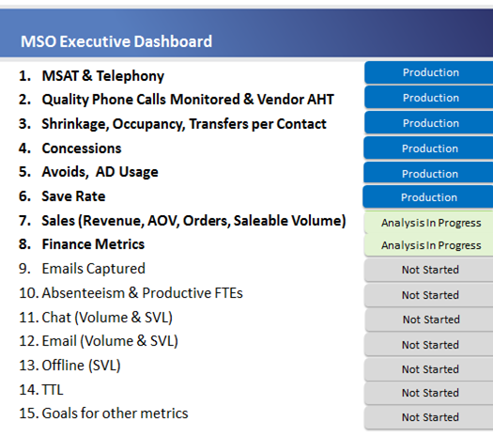

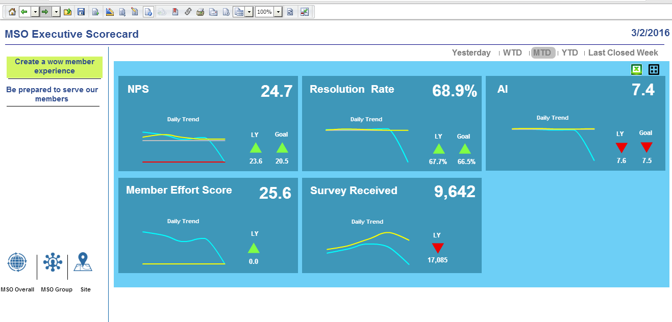
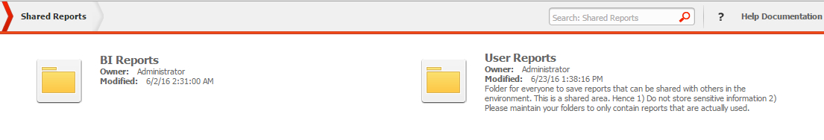
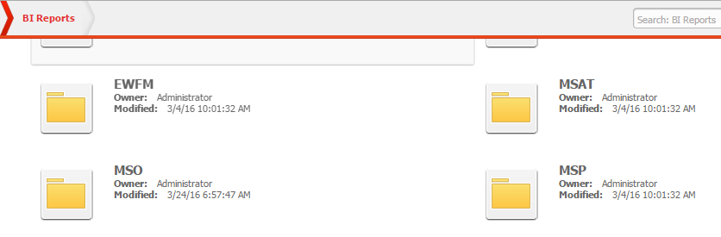
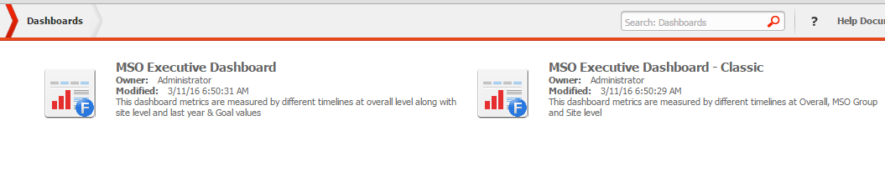
Automated Business Performance Reporting for Member Services Organization
Leading US Home Appliances and Repair Retailer
Key Digital Trends in the Auto Industry
The Problem: Periodic review of business performance is a very important activity for the senior executives but it is typically limited by the availability of business reports in a timely manner
The “Before” State
LatentView Solution
The “After” State
the
Business performance review of all the groups under the Member Services Organization (MSO) of the large US retailer was more of a monthly / quarterly activity
Audited existing data architecture and reports, redesigned & implemented business aligned data architecture, standardized & automated existing business reports, built new business aligned dashboards like associate performance dashboard & returns rate dashboard
Executive level weekly business performance review with monitoring against the financial objectives & comparing using common metrics across groups in a single platform resulted in better operational efficiency & improved customer satisfaction by 5 basis points
Drive operational excellence
Drive profitable sales
Meet financial commitments
7

Slide 25
MSO Dashboards (1/4)
The project was to aimed at enabling MSO Executive Dashboards on the MicroStrategy platform to show the complete MSO key metrics for the leadership team for various categories / groups by providing visualization on MicroStrategy
Quick Temporal Toggle Filters
Change w.r.t to last time period
Drive operational excellence
Target for chosen time period
Drive profitable sales
Meet financial commitments
KPI value for chosen time period
Navigational Bar for quick move between voice channel, customer satisfaction, operations & other areas
Daily Trend of KPI values
Beckon Scorecard Format showing current value of KPI, target, comparison to previous time period and a quick trend graph

Slide 26
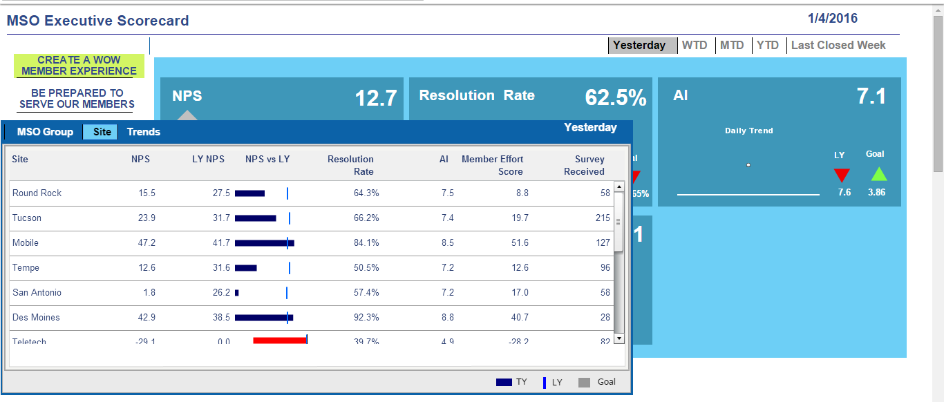
MSO Dashboards (2/4)
Geographic or site specific breakdown view of the KPIs and comparisons
Summary table of KPI metrics for easy comparison among geographic regions

Slide 27
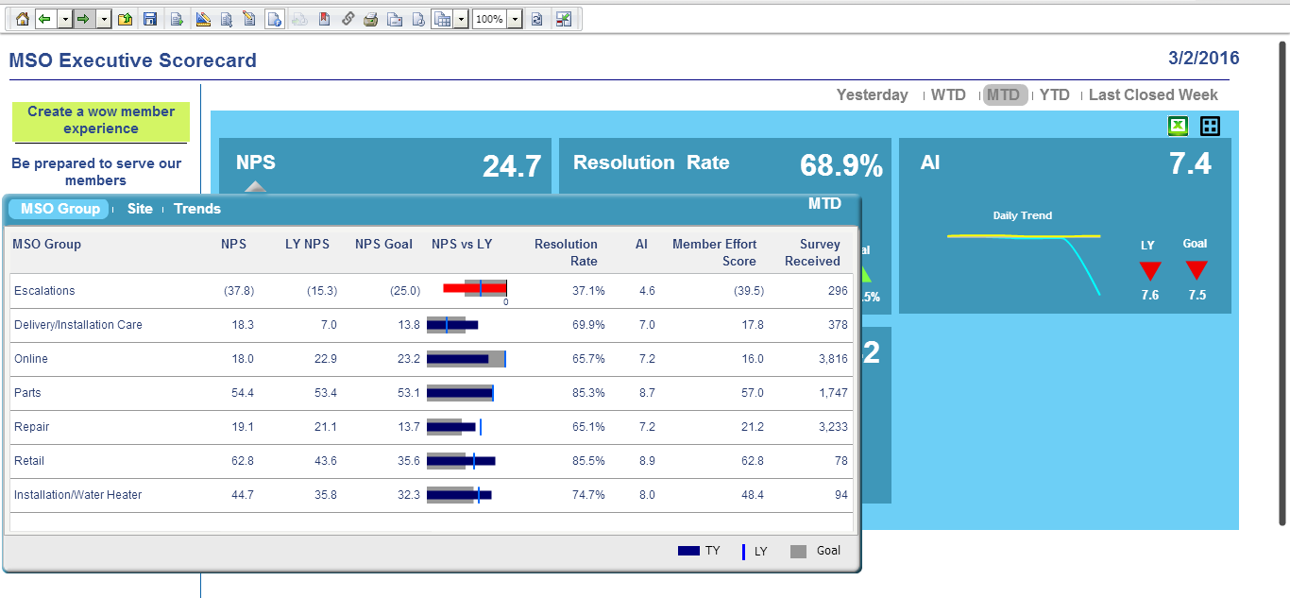
MSO Dashboards (3/4)
Ability to download specific chosen data based on applied filters
MSO group specific breakdown view of the KPIs and comparisons

Slide 28
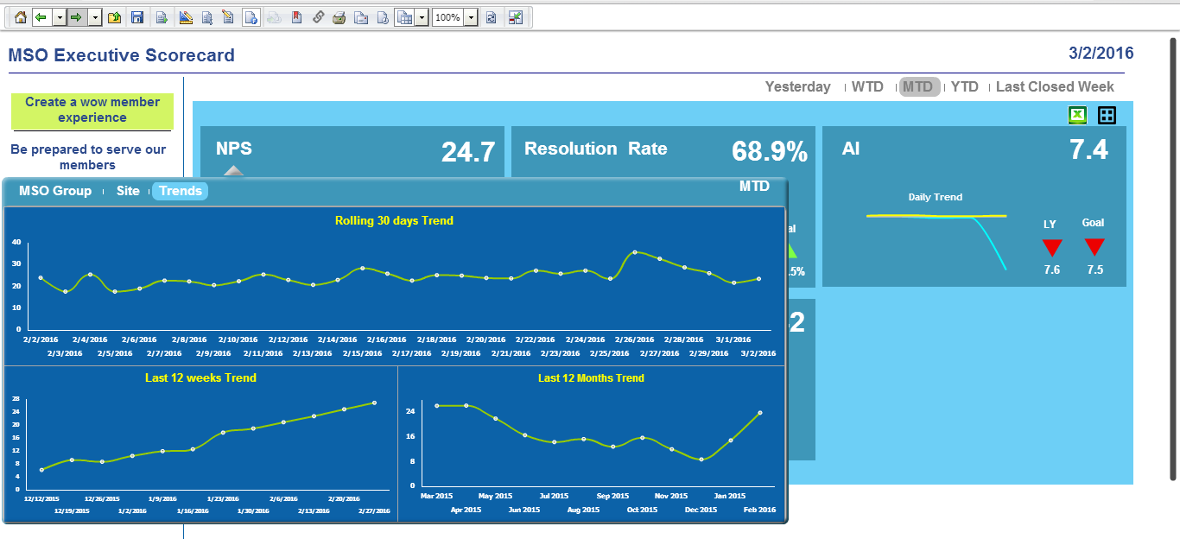
MSO Dashboards (4/4)
Daily / Weekly and Monthly trends of the KPI

Slide 29
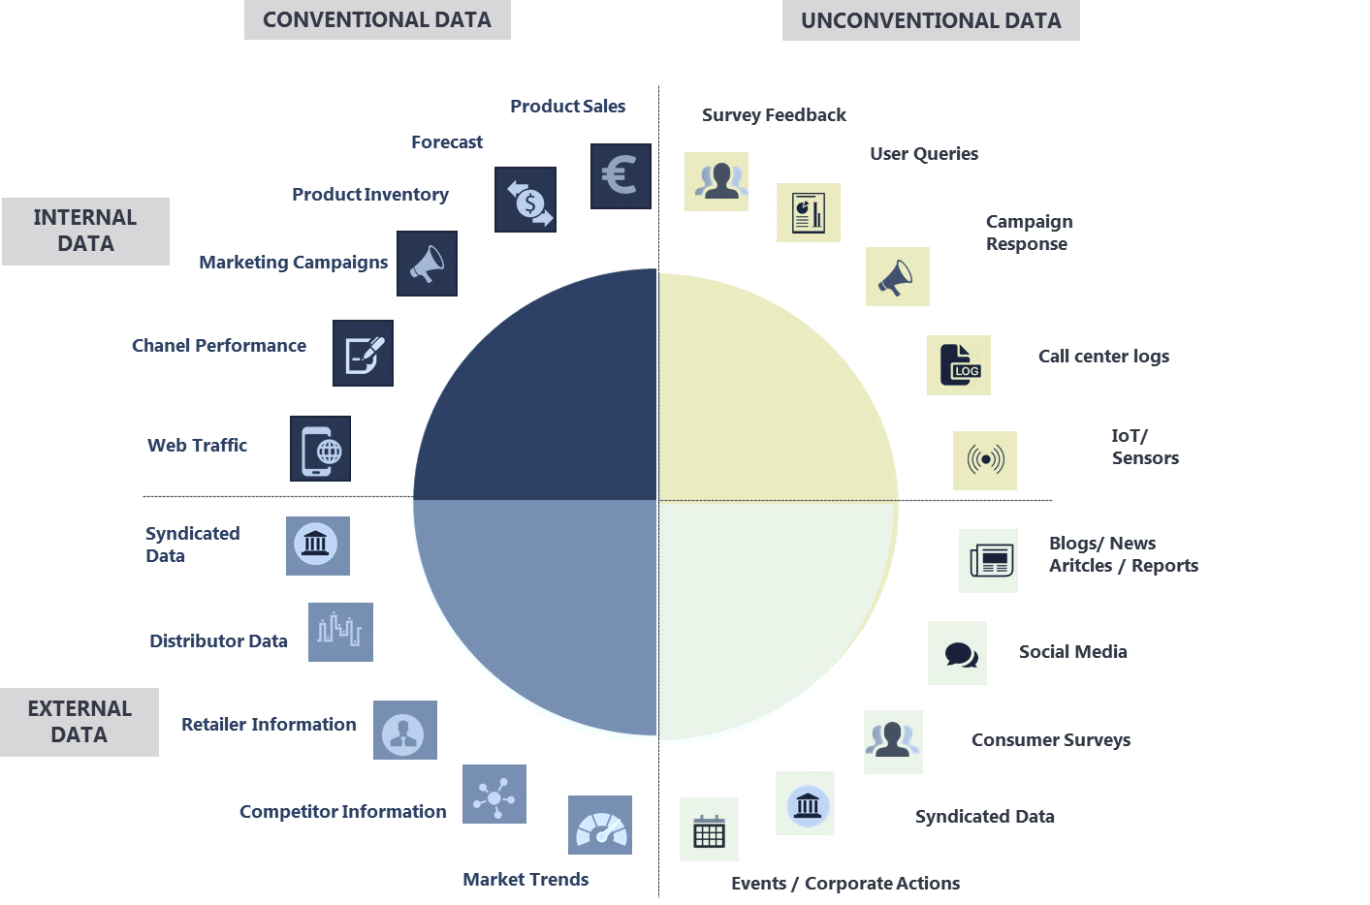
LatentView’s Data Integration + Visualization Experience
Data Sources
Data Integration Layer
Visualization Layer
-based reporting system
Flat Files
ETL
Historical data
API
Extraction
Transformation
Loading
API
API
Meta data
API
Raw data
Summary data
Staging tables
Data mart
Case Studies:
Built MicroStrategy based web application as a self service tool for the analytics and business teams of a large US based online travel agency. The self service portal enabled quick adhoc analyses that led to faster decision making for all mktg. activities, especially campaigns.
Self Service Tool

Slide 30
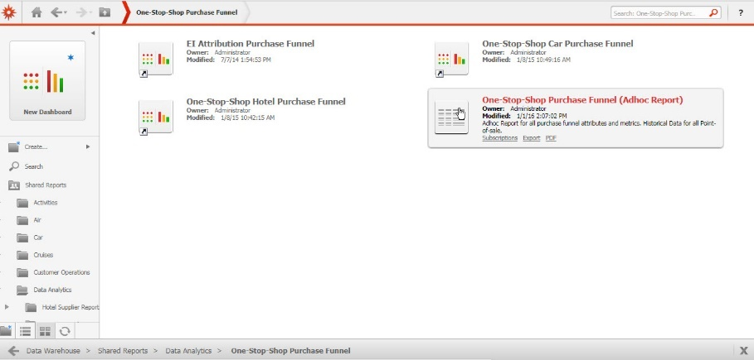

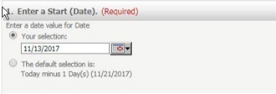
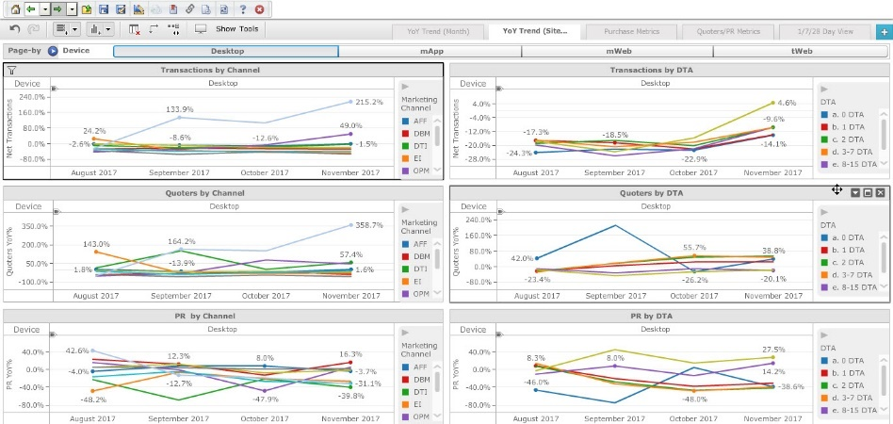
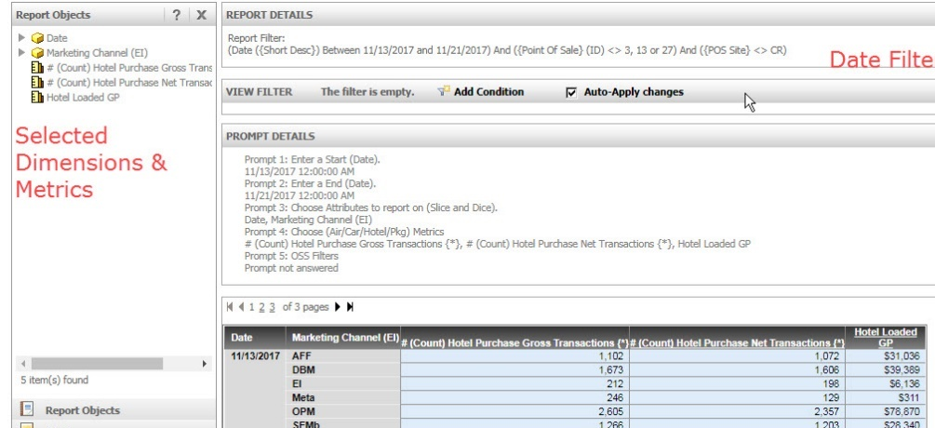
Prompt Marketing Decisions with MicroStrategy based Web Application
Leading US based Online Travel Agency
The Problem: Lack of unified view on marketing KPIs across multiple business functions prevents large organizations from “swimming the same direction” towards enterprise goals
The “Before” State
LatentView Solution
The “After” State
Client’s marketing analytics environment reports offered limited perspective & were generated from various sources of data creating multiple versions of truth, follow-up analyses were not easy
Built MicroStrategy based web application & marketing dashboards for all 3 business units, Car, Hotel & Flights. Web Application was designed to enable quick adhoc analysis across any dimension like device, period, channel etc.
Real time dashboards offered unified view and served as single source of truth and enabled quick adhoc analyses that led to quicker decision making especially for campaigns

Slide 31
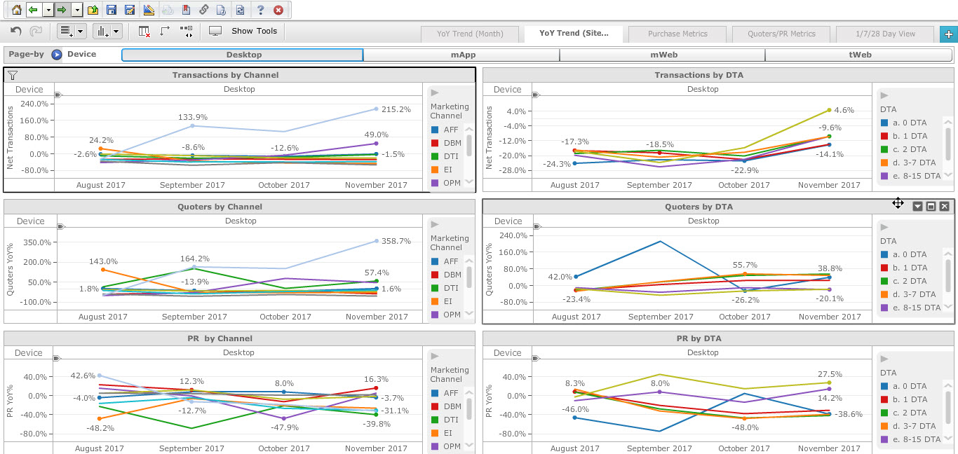
MicroStrategy based BI platform & Marketing Dashboards

Slide 32
Thank You

